Slide 1
REMOVE THIS SLIDE BEFORE PRESENTING
Hi!
For more details, see the comments on the slides (Review tab > Show Comments)
I’m Archana
Big changes
Slides 18, 26, 33, 43 – The AWS service names have been edited to match the Service Names wiki. Please review to confirm that the intended services have been referenced.
Slide 4 – The slide title has been adjusted to avoid repetitiveness.
Slide 7 – I removed the double emoticons on this slide.
Slide 8 – I edited the quote/affiliation on this slide for accuracy. Please consider if you need to include this quote as part of your slide content (see comment). I have hidden the slide and created a duplicate without the quote pending confirmation that you would still like to use it.
Slide 14 – Please review the minor language change on this slide. Additionally, please confirm that the diagram labels are in the correct order (see comment).
Slide 31, 37, 38 – Please review comment regarding font size for screenshots.
I’m the contracted technical editor who reviewed this presentation. My role is to ensure the AWS event content is accessible, appropriate, and accurate. To that end, I’ve made some edits throughout your slide deck.
See the summary on the right for details on the edits.
If you have any questions or feedback, please feel free to reach out to the Event Content Editing team (event-content-editing@amazon.com).
This edited version is the one approved to present. If you need to make changes to the deck before presenting, please schedule an onsite speaker ready room (SRR) editing appointment when the form opens. The technical editing team will review the changes and add them to the controlled version of the deck.
Thank you!
Little changes
Corrected spelling, grammar, and punctuation
Ensured correct AWS service names
Applied consistent capitalization (sentence case)
Applied the updated template, colors, layouts, and fonts
Adjusted line weights to the minimum standard (1.5 pt)
Adjusted font sizes to the minimum standard (12 pt), where possible
Minor edits for AWS style

Slide 3
Scaling .NET applications with asynchronous workflows
XNT404
Norm Johanson (he/him)
Ashish Bhatia (he/him)
Senior Software Development Engineer
AWS
Senior Solutions Architect
AWS

Slide 4
What we will cover
Why build an event-driven architecture?
Integration patterns with Amazon SQS, Amazon SNS, and Amazon EventBridge
Observability using Amazon CloudWatch and AWS X-Ray
Lots of demos
Notes:
In this session, we are going to cover
“Challenges with API based design and why we should look at building event driven architecture”
We are going to talk about integration patterns using Amazon services like SQS, SNS and event bridge
We are going to review patterns to implement observability and metrics

Slide 5
Microservices start simple
POST
/order
POST
/invoice
Order service
Invoice service
😀
201
201
Client
Notes:
So if you’ve made the move to microservices, you’ll probably find this kind of architecture pretty familiar.
Micro-services start simple. This is a standard synchronous API-based service. In this case when a client makes a request to the order service, it has to make a downstream request to the Invoice service, and once it gets a successful response, it can respond back to the client with a success message, provide a confirmation number, and the customer is happy. And this works great when you’ve got a nice, simple system like this.
And this works great when you’ve got a nice, simple system like this.

Slide 6
Architecture v2
Invoice service
Order service
Fulfillment service
Forecasting service
Notes:
Owner: Ashish
But what happens when you start adding more services to the e-commerce system e.g. invoice, fulfillment and forecasting service. As you can see, order service is acting as an orchestrator and communicating with all these different services.
Well there’s nothing wrong with having a lot of systems that are interested in the data from this order service. What is problematic is that in a API-oriented design, the order service needs to know about all these other boxes.
in that to integrate with the order service example, the system has evolved and order service now needs to integrate with
We talk a lot about how great microservices are because they are “decoupled”, but the order service still needs to know how to locate these other endpoints, it needs to understand how to make the appropriate API calls, what to do if one of those calls fails, it needs to have the appropriate retry logic and error handling and all that other stuff baked in for each of the services it talks to.

Slide 7
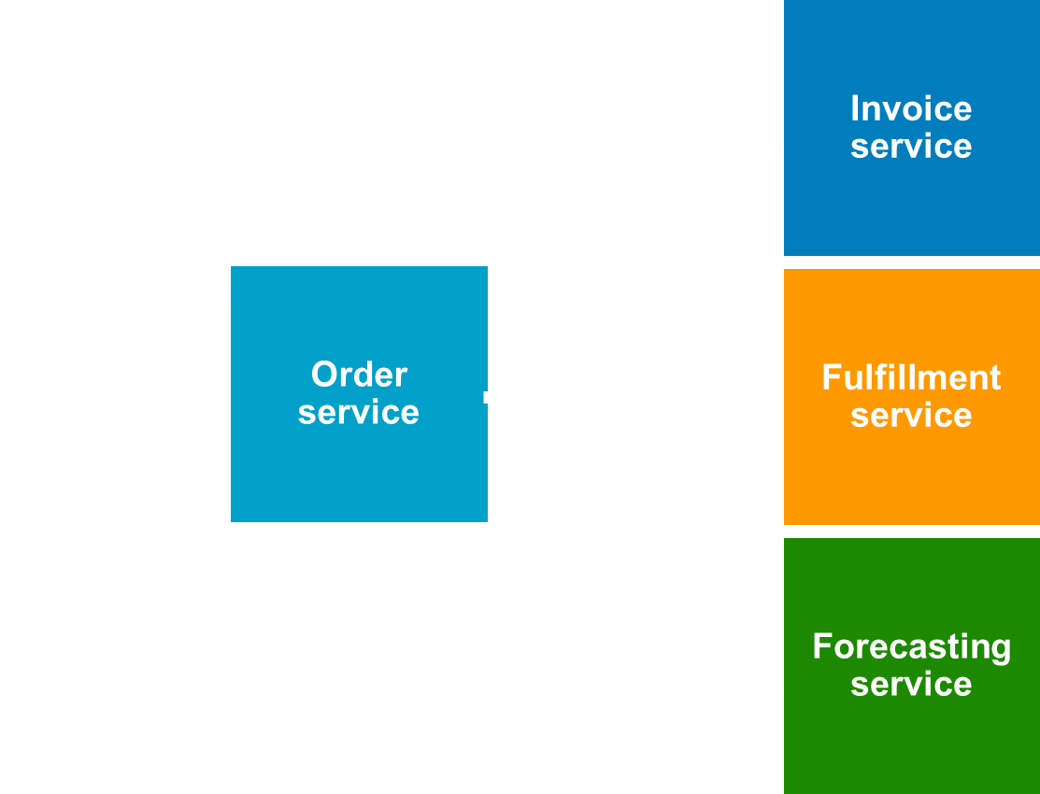
Synchronous API challenges over time
Consumers
Coupling between producers and consumers
Evolve architecture – new services
Retry logic and error handling
Blocking clients
😩
Producer
Client
Notes:
In an API oriented design, the architecture poses challenges such as:
Tight coupling between producers and consumers. Order service is acting as an orchestrator and need to know about all downstream services. It is also a single point of failure
If we have to add a new service e.g. notifying customers when a new service is added, we have to make changes to the producer. This makes it difficult to keep order services in sync as other services keep on evolving
Order service need to make appropriate API calls and SDK integration. If one of those calls fails, it needs to have the appropriate retry logic and error handling
4. One of the limitations here is that the downstream services must keep up with the order service workload. What happens if your application suddenly gets a real massive burst in traffic and app is unable to process the data fast enough. With this architecture, API call will fail and data will be lost e.g. orders.
Now, this data could well it simply fails and the data gets lost and you lose whatever that information is i.e. could be orders, could be something critical to your business we can solve these issues with a decoupled integration
Component connectivity also define your system essential properties:
Can each component scale and fail independently?
How do you handle failures and retries?
Any upstream systems waiting on slow responses from downstream ones
Well there’s nothing wrong with having a lot of systems that are interested in the data from this order service. What is problematic is that in a API-oriented design, the order service needs to know about all these other boxes.
Need to know how to locate these other endpoints
How to make appropriate API calls. If one of those calls fails, it needs to have the appropriate retry logic and error handling
It needs to have SDK
Difficult to keep order service in sync as other services keep on evolving
We talk a lot about how great microservices are because they are “decoupled”, but the order service still needs to know how to locate these other endpoints, it needs to understand how to make the appropriate API calls, what to do if one of those calls fails, it needs to have the appropriate retry logic and error handling and all that other stuff baked in for each of the services it talks to.
Now this order service is taking on a lot of responsibilities. Even if each of these downstream services publishes a really nice API, the order service is still responsible for talking to each of them. It needs to understand the retry semantics it’s supposed to use for each of these services, it has to bundle in an SDK for each of them. In addition, it becomes increasingly challenging to keep order service in sync as the other services evolve and make changes to the interface.
Alt: And there’s nothing wrong with having a lot of systems that are interested in the data from this order service. What is problematic is that in a API-oriented design, the order service needs to know about all these
Can each component scale and fail independently?
Are upstream systems waiting on slow responses from downstream ones?
Do interdependent teams need to tightly coordinate to launch new features?
How do you handle failures and retries?
How do you integrate SaaS application events?
other boxes.

Slide 8
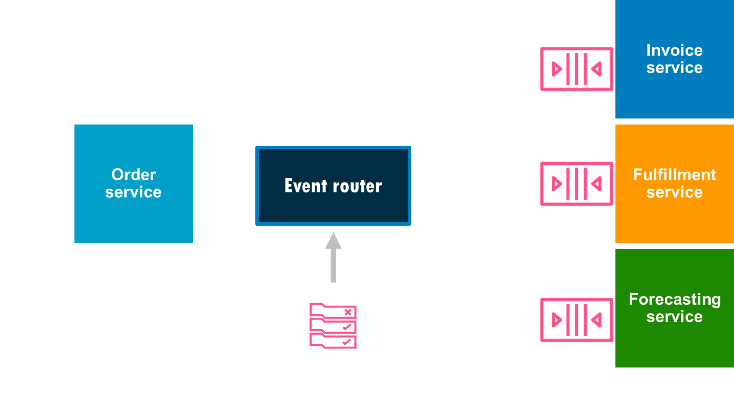
Reliable, resilient, and independently scalable
Invoice service
😀
Event store
Order service
Event router
Fulfillment service
Client
Forecasting service
Routing/filtering rules
“If your application is cloud-native, or large-scale, or distributed, and doesn’t include a messaging component, that’s probably a bug.”
Tim Bray
Self-proclaimed General-purpose Internet-software Geek
Notes:
How do we solve the challenges. One of the option is through pub..sub or event router pattern..
Publish-subscribe pattern, is a messaging pattern in software architecture where a publisher creates a message and sends it to a predetermined location for one or more subscribers to consume. Consumer will subscribe to topics of interest and will get notified when a message arrives.
As you can see, this architecture breaks the tight coupling. Order service is abstracted out from downstream services. We can evolve the architecture i.e. new services can be added to enhance the business process without making changes to order service. Also, we can make changes to any existing service and no changes are required to the order service as it is abstracted out from the implementation details.
To look at it from the consumer’s perspective, a consumer would subscribe to a topic of interest and when the publisher publishes a message to the topic, the consumer and any other subscribed consumers would receive the message.
By. Applying a fanout pattern and event router, we can break the tight coupling. In this example, we introduced event router as a reliable way of publishing events from our order service and making sure that they are reliably processed by all of the downstream services.
The predetermined location has different names and has differing structures in different systems. However, in this tutorial we will refer to that predetermined location as a “topic”.

Slide 9
Reliable, resilient, and independently scalable
Invoice service
😀
Event store
Order service
Event router
Fulfillment service
Client
Forecasting service
Routing/filtering rules
Notes:
Lets look at how we can decouple systems and solve the challenges that we observed compared to direct integration.
One of the option is through pub..sub or event router pattern.. In the next section, I will walk through the 3 most common patterns to solve the architecture challenges that we discussed with API based integration.
Publish-subscribe pattern, is a messaging pattern in software architecture where a publisher creates a message and sends it to a predetermined location for one or more subscribers to consume. Consumer will subscribe to topics of interest and will get notified when a message arrives.
As you can see, this architecture breaks the tight coupling. Order service is abstracted out from downstream services. We can evolve the architecture i.e. new services can be added to enhance the business process without making changes to order service. Also, we can make changes to any existing service and no changes are required to the order service as it is abstracted out from the implementation details.
To look at it from the consumer’s perspective, a consumer would subscribe to a topic of interest and when the publisher publishes a message to the topic, the consumer and any other subscribed consumers would receive the message.
By. Applying a fanout pattern and event router, we can break the tight coupling. In this example, we introduced event router as a reliable way of publishing events from our order service and making sure that they are reliably processed by all of the downstream services.
The predetermined location has different names and has differing structures in different systems. However, in this tutorial we will refer to that predetermined location as a “topic”.

Slide 10
Asynchronous point-to-point model (queue)
Notes:
Lets look at how we can decouple systems and solve the challenges that we observed compared to direct integration when building distributed systems
First pattern is Async point to point using a queue

Slide 11



Asynchronous point-to-point model (queue)
Advantages
Decreases tight coupling
Resilient to receiver failure
M1
M2
M1
M2
Ack
Sender
Queue
Receiver
Notes:
As you can see here we have a sender and receivers.
But, this time we’ve put queue in the middle. So, the sender is sending messages to the queue. The receiver is going to process messages from the queue.
. In this case, the receiver is polling the queue and saying hey I am ready to process another record and what have you got now. This now solves the problem we had earlier i.e. if order service gets super busy it just puts more messages in the queue and if the downstream services can’t process them fast enough, that’s ok because the information is not lost so as long as it is not time critical
.
queue right over here so the producers produce messages that go into the queue and the consumers consume those messages
For receiver control, this allows the backend to throttle the pressure on backend system like database

Slide 12
Asynchronous point-to-point model (queue)
Advantages
…
Dead-letter queue (DLQ) for errors
Messages in DLQ can be added back to source queues (redrive)
M2
Dead-letter queue
M1
M2
M1
Sender
Queue
Receiver
Notes:
A very common scenario is that a receiver is trying to process the message from main queue and encounters an error. May be, there is a failure with a dependency or a service that you are trying to call is not available. For these scenarios, the recommended pattern is to move the message to DLQ where you can then examine it later and run some analysis and see why that message wasn’t processed but it is essentially goes off the main queue and to the secondary dead letter queue.
A dead-letter queue is, it’s just another regular SQS queue that we can temporarily move messages into. So rather than keeping that message decline in that primary SQS queue, once we reach the number of retries that we’ve specified, the message will get transferred to that dead-letter queue.
The advantage of the dead-letter queue is that we can transfer those inappropriate messages, and we don’t simply have to keep them in that SQS queue eternally.
After you create a queue to act as a dead letter queue, you must configure the other queues that route unprocessed messages to the dead letter queue. To do this, specify a redrive policy that identifies the queue to use as a dead letter queue and the maximum number of receives by individual messages before they are routed to the dead letter queue.
DLQ Redrive goal is moving standard unconsumed messages out of a dead-letter queue back to its source queue(s).
We can even examine the message attributes and corresponding metadata available for unprocessed messages in the dead-letter queue. Dead-letter queue redrive is an asynchronous workflow. It only redrives the messages available in the dead-letter queue when we start the redrive task. Also, if new messages are sent to the dead-letter queue, we can begin another redrive task once the last task is finished.

Slide 13
Asynchronous point-to-point model (queue)
Disadvantages
Response correlation
M1
Receiver
M1
M2
Sender
M2
Receiver
Notes:
One of the key challenges with this architecture is response correlation. How does the sender know that the receiver was able to process the message or get a response back? There are patterns available to handle this e.g. using correlation id.

Slide 14


AWS services: Amazon SQS
Point-to-point (queue)
Amazon Simple Queue Service (Amazon SQS)
Fully managed message queue
Scales almost infinitely (standard queues)
Simple, intuitive API
Dead-letter queue (DLQ) support
Standard and FIFO options
M2
M3
M1
M3
M2
M1
Receivers
Sender
Amazon SQS
Notes:
To implement a queue pattern on AWS, you can take advantage of Amazon simple queue service or sqs. SQS is a fully managed queue for storing messages as they travel between different applications or micro-services. Messages are stored redundantly across multiple servers
that enables you to decouple and scale micro services distributed systems.. SQS stores the message durably by storing copies across multiple AZ. When you want to receive message, all what you need to do is to call ReceiveMessage and provide queue url. Responsibility of SQS to return the message and hand it over to receiver. Message
For most standard queues (depending on queue traffic and message backlog), there can be a maximum of approximately 120,000 in flight messages (received from a queue by a consumer, but not yet deleted from the queue).
here's this idea of long polling where a consumer can poll the queue and if it doesn’t find a message you could still sit there
for about up to 20 seconds and still receive a message instantaneously if it comes into the queue and that’ll actually save you money because you're
not continuously polling for messages and getting nothing okay that's one
thing the other thing is this visibility timeout so when a consumer is processing a message there's this idea that other consumers will not see that message because we don't want the same message process twice by by other consumers so so when a consumer is processing that
message we can create this visibility timeout so we can set it I'll show you
SQS provides a fully managed queue for storing messages as they travel between different applications or micro-services. Messages are stored redundantly across multiple servers. in SQS the consumer itself must delete the message comes at you after receiving and processing it so here when the message is received it remains on the queue and to prevent other consumers who process this message again and again
sqs sets a visibility timeout the default value of visibility timeout in sqs is 30 seconds the minimum is zero seconds and the maximum that you can set
is 2l ours and this visibility timeout is applied to the queue on the whole and not specifically to the message itself
sqs it's a system that must pull the queue to discover new events so whenever an event is delivered
to the queue there's nothing that’s gonna get invoked there's no system that automatically can become aware of it you need to have some separate thread that’s pulling the queue to discover when new events get delivered and have a
mechanism to actually process it and then delete the message from the queue.
sqs is a fully managed Message Queuing service for reliably communicating between distributed software components and micro services at any scale sqs makes it simple to decouple application
components so they can run and fail
independently this as you build
applications that are fault tolerant and
easy to scale with sqs you can exchange
messages between any number of systems
at any volume without losing messages
and without the overhead of managing
dedicated messaging software and
infrastructure

Slide 15

Message channels: FIFO queue
FIFO queue
Message groups
Group ID - X
C
A
Order!
Group ID - Y
D
C
B
A
D
C
B
A
D
C
B
A
D
B
Receivers
Queue
Queue
Sender
Receivers
Sender
Guaranteed ordering
Grouped by message group ID
Notes:
SQS supports 2 different types of queues i.e. standard and FIFO. If your application needs exactly once processing and guaranteed delivery, then you need to use FIFO queues.
This lets you use sqs for systems that depend on receiving messages in exact order and exactly once. Example, at Amazon, price updates are published using FIFO queues.
MessageGroupId is required for FIFO queues. You must associate a non-empty MessageGroupId with a message. If you don't provide a MessageGroupId, the action fails.
Lets talk about a common use cases where you don't need strict ordering of all messages. Imagine a system that keeps track of user data. You may want to get notification of changes about particular user in order, but you may want to process notification about different users in parallel. If you use a single FIFO queue, all notifications will get processed in sequence, no parallelism is possible. If you use a queue per user, then with a lot of users you need a lot of queues and you need to call ReceiveMessage on each queue to find if there's anything to process. You can use a single FIFO queue and provide user id as MessageGroupId. You can then poll for messages from that single queue and SQS FIFO queue will give you message that belong to same MessageGroupId in order, but messages with different MessageGroupIds in parallel.
for example FIFO queues help ensure mobile banking transactions are processed in the correct sequence and the price updatesfor online retail sites like Amazon are
processed and published in the right order FIFO queues complement our existing sqs standard queues which offer higher throughput best effort ordering and at least once delivery the same API functions apply to both types of cues.
The message group ID is the tag that specifies that a message belongs to a specific message group. Messages that belong to the same message group are always processed one by one, in a strict order relative to the message group (however, messages that belong to different message groups might be processed out of order).
When you send a message to a FIFO queue, you specify a message group ID. Amazon SQS ensures that messages in the same group are delivered to Lambda in order. Lambda sorts the messages into groups and sends only one batch at a time for a group. If your function returns an error, the function attempts all retries on the affected messages before Lambda receives additional messages from the same group.
Example: Amazon SQS with sender-provided message group IDs—no further consumption as long as messages with particular message group ID are invisible..
Consistency between SQS queues and dead-letter queues, it’s crucial:
So, for example, the dead-letter queue of a FIFO queue must also be a FIFO queue. Likewise, the dead-letter queue of a standard queue must also be a standard queue.
The message group ID is the tag that specifies that a message belongs to a specific message group. Messages that belong to the same message group are always processed one by one, in a strict order relative to the message group (however, messages that belong to different message groups might be processed out of order).
f you need all messages in a FIFO queue to be delivered in strict order, just use the same MessageGroupId for all messages. You can name it "default-group". Having that will work just fine, but remember that a FIFO queue like that will not give out the next available message until the previously received message is deleted -> this is the way such queue guarantees processing in order. So you maximum throughput of a pure FIFO queue like that will be limited.

Slide 16
Amazon SQS demo

Slide 17


AWS SDK for .NET SDK as a service
AWS SDK for .NET SDK build service
Python build queue
Rust build queue
Go build queue
Java build queue
. . . build queue
Two types of builds
Preview builds a single service
Release builds all services
300+ NuGet packages
4 .NET targets per package
P1
R1
P2
P1
R1
P2
Overview of steps
Clone repository
Apply new service model(s)
Run AWS SDK for .NET code generator
Commit source changes (release only)
Run MSBuild
Sign artifacts
Generate API docs (release only)
Upload artifacts
Push to NuGet.org (release only)
.NET build queue
AWS SDK release orchestrator

Slide 18
Amazon SQS to Lambda: Tips
Concurrency can be controlled by batch size and reserved concurrency
Visibility – Check that visibility timeout is always greater than function duration to avoid duplicate invokes
Number of messages – Declared batch size is not guaranteed; the number of messages returned by Amazon SQS in each API call depends on a variety of factors such as the queue depth, message distribution on Amazon SQS servers, et cetera

Slide 19

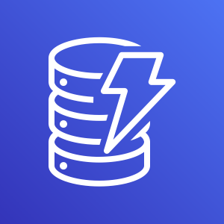


Amazon SQS to Lambda
Message processing
No need to provision capacity
Automatic polling and deletion of messages
Supports batch processing
1. Message inserted into to a queue
2. Lambda polls queue and invokes function
3. Lambda removes message from queue
Amazon SQS
AWS Lambda
Amazon DynamoDB
Notes:
Owner: Norm
You can use an AWS Lambda function to process messages in an Amazon SQS queue. Lambda polls the queue and invokes your Lambda function synchronously with an event that contains queue messages.
A Lambda function can process items from multiple queues (using one Lambda event source for each queue). You can use the same queue with multiple Lambda functions.
If you associate an encrypted queue with a Lambda function but Lambda doesn't poll for messages, add the kms:Decrypt permission to your Lambda execution role.
Lambda polls the queue and invokes your Lambda function synchronously with an event that contains queue messages. Lambda reads messages in batches and invokes your function once for each batch. When your function successfully processes a batch, Lambda deletes its messages from the queue..
By default, Lambda polls up to 10 messages in your queue at once and sends that batch to your function. To avoid invoking the function with a small number of records, you can tell the event source to buffer records for up to 5 minutes by configuring a batch window. Before invoking the function, Lambda continues to poll messages from the SQS standard queue until the batch window expires,

Slide 20
Amazon SQS demo recap
Sending, receiving and deleting messages
Managing visibility of messages
FIFO queues with message groups
Batching
Notes:
Message encryption with AWS Encryption SDK
https://docs.aws.amazon.com/encryption-sdk/latest/developer-guide/

Slide 21

Amazon MQ
Amazon MQ
Active Amazon MQ and RabbitMQ broker engine options
Manages the provisioning, setup, and maintenance of message brokers
Connects to current applications using existing SDKs or libraries
M1
Receiver
M1
M2
Ack
Sender
Amazon MQ
M2
Receiver

Slide 22
Asynchronous point-to-point model (Pub/Sub )
Notes:
The next pattern that we are going to talk about to build distributed applications is pub..sub.. In this architecture, there are 2 primary actors i.e. Publisher and subscriber.

Slide 23
Pub/Sub Architecture
M2
M1
Receiver 1
Topic
M1
Sender
M2
M1
M2
Receiver 2
Notes:
Publish-subscribe pattern, is a messaging pattern in software architecture where a publisher creates a message and sends it to topic. Consumer will subscribe to topics of interest and will get notified when a message arrives. In this architecture pattern, there can be more than 1 consumer for the same message.
As you can see, this architecture breaks the tight coupling. Order service is abstracted out from downstream services. We can evolve the architecture i.e. new services can be added to enhance the business process without making changes to order service. Also, we can make changes to any existing service and no changes are required to the order service as it is abstracted out from the implementation details.
Pub/Sub enables you to create systems of event producers and consumers, called publishers and subscribers. Publishers communicate with subscribers asynchronously by broadcasting events, rather than by synchronous remote procedure calls (RPCs).
Publishers send events to the Pub/Sub service, without regard to how or when these events are to be processed. Pub/Sub then delivers events to all the services that react to them. In systems communicating through RPCs, publishers must wait for subscribers to receive the data. However, the asynchronous integration in Pub/Sub increases the flexibility and robustness of the overall system.
Publishers communicate asynchronously with subscribers by sending messages to a topic, which is a logical access point and communication channel. Clients can subscribe to the SNS topic and receive published messages using a supported endpoint type

Slide 24
Amazon Simple Notification Service (SNS)
Blue
Blue
Amazon Simple Notification Service (Amazon SNS)
Serverless pub/sub service
Message filtering
Messages are pushed to subscribers
Application-to-application messaging, for example, using Amazon SQS, HTTP(S) or Lambda functions
Application-to-person messaging by using email or SMS
M1
M1
Blue channel
Receiver 1
Sender
SNS
Green
Green
M2
M2
Green channel
Receiver 2
Notes:
To implement a pub..sub pattern on AWS, you can take advantage of Amazon SNS service. AWS SNS is a push-based messaging service that sends messages from publishers to many subscriber endpoints. This eliminates the need to periodically check or “poll” for new information and updates.
Subscribers, on the other hand, receive the published messages from the SNS service over supported network protocols like Amazon SQS, AWS Lambda, or HTTP/ HTTPS.
SNS uses a publisher subscriber system so you may own a topic and you publish to that topic and subscribers get notified of events that are delivered to that topic..
A dead-letter queue is an Amazon SQS queue that an Amazon SNS subscription can target for messages that can't be delivered to subscribers successfully. Messages that can't be delivered due to client errors or server errors are held in the dead-letter queue for further analysis or reprocessing.

Slide 25
Amazon SNS demo
Notes:
Owner: Norm

Slide 26


Communicating status
AWS SDK for .NET build service
Two types of builds
Preview builds a single service
Release builds all services
300+ NuGet packages
4 .NET targets per package
P1
R1
P2
P1
R1
P2
.NET build queue
AWS SDK release orchestrator
Overview of steps
Clone repository
Apply new service model(s)
Run AWS SDK for .NET code generator
Commit source changes (release only)
Run MSBuild
Sign artifacts
Generate API docs (release only)
Upload artifacts
Push to NuGet.org (release only)
P1
R1
P2
P1
R1
P2
R1 (failed build)
.NET build status topic
SDK for .NET team paging email

Slide 27
Amazon SNS demo recap
Publishing messages
Filtering messages
Processing Amazon SNS messages with .NET Lambda functions

Slide 28
Asynchronous message-router model (bus)
Notes:
Next messaging pattern that we are going to discuss is message router or bus..

Slide 29


Asynchronous message-router (bus)
Blue
Advantages
Decouple sender and receiver
Centralized routing rules
Build event-driven architecture
Blue?
M1
Blue
Green
Receiver
M1
M2
Sender
Bus
Green
Green?
M2
Receiver
Notes:
This pattern is primarily used to build event driven applications.
In event-driven applications, you have the event producer, the event bus and the event consumer.
The event producer is the event source that the events come from. It is depicted as sender
This can be an AWS service, it can be a custom event or an event that comes from a third party SaaS app.
The event bus acts as an event router to route the events and perform rules processing.
The event consumer listens for events and acts only upon the events they're interested in.
In this architecture, an event is announced, but the event producer doesn’t expect a response or know about the activities of the consumers. There could be any number of consumers listening, and you can add additional consumers as new features are built.
There’s no latency for the producer, because the events are processed asynchronously. There’s also no single point of failure, because a consumer failing doesn’t impact the other consumers or the producer.
For example, let's say you're a developer at an e-Commerce company and you're building a serverless e-Commerce application.
Your team is in charge of the account creation and authentication process.
You build the login flow and raise an event when a new user creates an account.
When the event is raised, other teams can be alerted.
The marketing team can listen for the account created event and act on it.
For example, they can send promotional emails.
In this decoupled architecture, event producers and consumers don't have to know about each other.
They only have to listen to events and act accordingly when they're interested in that event.
This can be speed up development by reducing the complexity caused by building new features.
In this pattern, A router consumes a message from one message channel and republishes it to a different channel based on specified conditions.
we have an event bus which intelligently filters events and routes them to the right subscribed consumers..
More and more customers are adopting SaaS in their organization. And so we’re making it easier to incorporate SaaS data into your applications through services like EventBridge.
ion defined in the rule.
To route events from these sources to the correct target,the events must be placed on a corresponding event bus.

Slide 30
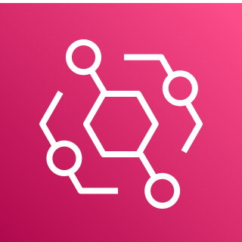
Asynchronous message-router (bus)
Blue
Advantages
Decouple sender and receiver
Centralized routing rules
Build event-driven architecture
Blue?
M1
Blue
Green
Receiver
M1
M2
Amazon EventBridge
Sender
Bus
Green
Green?
M2
Receiver
Notes:
At AWS, you can take advantage of Amazon EventBridge service to implement this pattern.
Eventbridge is a serverless event bus service. it helps you ingest and route events from aws services, your own applications and sas
Applications. it is a fully managed service so there’s no infrastructure to manage or provision scaling is managed for you and you only pay for what you use
or for the delivery of events

Slide 31
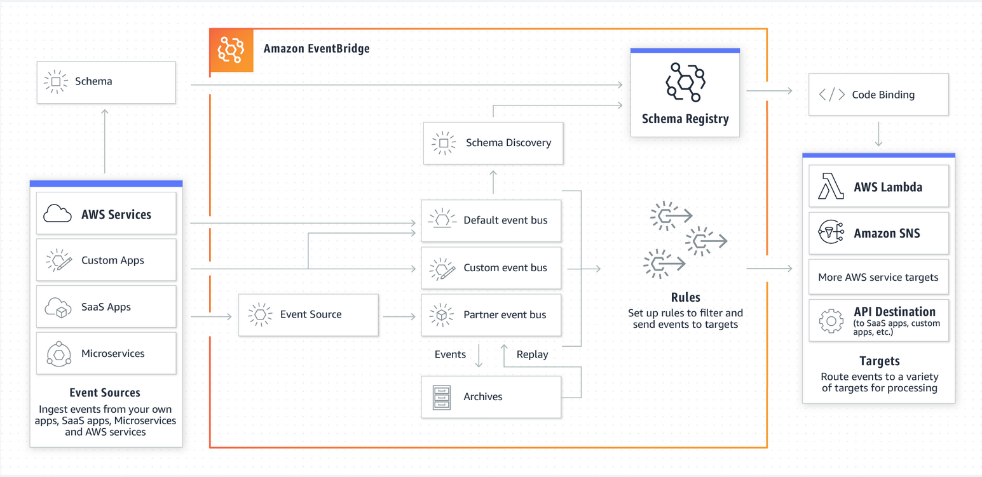
Amazon EventBridge
Amazon EventBridge is a simple, fully managed, pay-as-you-go, event bus service that makes it easy to ingest and process data from AWS services, your own applications, and SaaS applications
Notes:
EventBridge accepts events from many different event sources including over 200 AWS services, custom events from your Lambda functions or applications, and third party SaaS applications. We actively work with some of the most common 3rd party software services running at AWS – services like: Zendesk, Pagerduty, and MongoDB
When an event is raised, it needs to be published to event bus. There are three use-cases of event buses.
The first type is the default bus, which is always available in every account, and it's where AWS events are routed to.
The second type is a custom event bus. You can create custom event buses for your own applications to meet your business needs.
Lastly, you can also create SaaS event buses, which are created when you configure SaaS applications as an event source.
You specify an action to take when EventBridge receives an event that matches the event pattern in the rule.
When an event is raised that matches the rule, EventBridge sends the event to the specified target and triggers the action defined in the rule.
There are many potential event targets.
Event targets are what the event bus routes to once a corresponding event happens. Targets include AWS Lambda, Amazon Kinesis, AWS Step Functions, Amazon API Gateway, and even event buses in other accounts.
This flexible design allows you to create a wide variety of integration patterns based on your specific needs.
EventBridge enables our customers to use data from 3rd party integrations in their applications. m. We actively work with some of the most common 3rd party software services running at AWS – services like: Zendesk, Pagerduty, and MongoDB. EventBridge accepts events from many different event sources including over 200 AWS services, custom events from your Lambda functions or applications, and third party SaaS applications.
A rule matches incoming events from an event source and sends them to event targets for processing.
You specify an action to take when EventBridge receives an event that matches the event pattern in the rule.
One of the ways that EventBridge shines for building event-driven microservices is integrations. How much boiler plate code are you not needing to write and maintain with the direct integrations that EventBridge has to a variety of downstream consumers? In AWS, events are choreographed through Amazon EventBridge rules.

Slide 32
EventBridge demo
Notes:
We see customers frequently use serverless services like Lambda or Step Functions to consume incoming events. You can write code to transform or take action on the event within the Lambda function, or send it to another AWS service like an ML service or update a database record. With Step Functions, you can orchestrate a series of steps to take action on the event.
The reason customers choose serverless services is they have a natural affinity with event-driven architectures. Serverless services have native integrations with event services, only run when there are events to process, and scale up and down automatically as event volume changes.

Slide 33

AWS SDK release orchestrator
AWS SDK release orchestrator
Preview event
P1
R1
P2
P1
R1
P2
Preview rule
Prepare preview message
.NET build queue
AWS SDK for .NET build service
AWS SDK build event bus
Release rule
Release event
Prepare release message

Slide 34
EventBridge demo recap
Defined EventBridge
Created rules with content filtering
Processed EventBridge events with .NET Lambda functions

Slide 35
EventBridge and Amazon SNS use cases
EventBridge
Reacting to events from SaaS applications, AWS services (200+), or customer applications
Create rules that are applied across the entire event body to filter before pushing to consumers
Large number of target types
Amazon SNS
High throughput and low latency events published by custom applications or microservices
Very high fanout
Application-to-person (A2P): SMS, email, and mobile push notifications
Notes:
(thousands or millions of endpoints)
Standard topics. EventBridge can transform the message before pushing to subscriber..

Slide 36
Observability for asynchronous workflows
Notes:
We talked about patterns and services that you can leverage to build distributed systems. As you build distributed systems, one of the common challenge is how do I reconstruct a chain of events when the error happens or things are not working as expected. In a monolithic system, we can open a log file. But, this becomes difficult as we build micro-services and use cloud native services.
As engineers, we want a complete view of requests as they travel through your application with no-code and low-code motions.
For observability, customers can use Amazon CloudWatch and Amazon OpenSearch Service to set alarms; collect logs, metrics, and events; and monitor workloads, VMs, and containers across environments. In this section, I will like to share information on 2 services: Open Telemetry and Xray..
Customers can also create custom alerts for the performance of applications with Amazon Managed Service for Prometheus and create, explore, and share observability dashboards with Amazon Managed Grafana.
tso you can see right here this is like a really simple application but um it's already fairly distributed
there are a lot of moving parts there are a lot of separate services and as we move into a serverless world
this becomes even more distributed so microservices service serverless growth and scale
growth and diversity means that our systems become really really complicated it's
or as we'll call in a moment a trace id attached to all of these logs then you'd be able to do a query which
3:46
is find all the other logs that are in this transaction but with the traditional logging tool you don't have that because you don't

Slide 37


What is OpenTelemetry?
An observability framework for cloud-native software supported in 11 languages and growing
You use it to instrument, generate, collect, and export telemetry data (metrics, logs, and traces) for analysis to understand your software's performance and behavior
Export to AWS X-Ray for analysis that’s supported using a sidecar container or Lambda layer
Custom .NET Micro-service
ADOT Collector
AWS X-Ray
Notes:
observability is the ability to understand what’s happening inside a system from the knowledge of the external data it produces, which are usually logs, metrics, and traces.
Collecting application data is nothing new. However, the collection mechanism and format are rarely consistent from one application to another.
Having a common format for how observability data is collected and sent is where OpenTelemetry comes into play. OpenTelemetry is a framework that provide standardized set of APIs, SDKs and agents to enable developers to instrument their application once.
It supports SDKs in 11 languages and auto-instrumentation agents. Major partners such as Datadog, splunk, NewReclic as well as cloud providers like Microsoft, Google and AWS are contributing to it.
To instrument your application, you require 2 components: First is an OpenTelemetry SDK and second is the OpenTelemetry collector. Collector can be configured to receive instrumentation data and send that data to visualization tool like Xray.
With the AWS Distro for OpenTelemetry .NET, you can instrument your applications metrics and traces to multiple AWS monitoring solutions including Amazon CloudWatch, AWS X-Ray, and Amazon OpenSearch Service.
Using X-Ray with AWS Distro for OpenTelemetry requires two components: an OpenTelemetry SDK enabled for use with X-Ray, and the AWS Distro for OpenTelemetry Collector enabled for use with X-Ray.
open telemetry solves is standardizing the data that systems generate so that we have a standard common language for describing systems that allows
analysis tools to really get a much better sense of what systems actually are and it creates for a sort of green field of possibility to build new
analysis systems all on top of the same data but the reason why we need this is because transactions are becoming more and more distributed so what do i mean by a distributed
open telemetry is what we call the collector so the collector is a separate service that the sdk talks to so you tend to leave the sdk in a default mode
speaking otlp which is the native protocol for open telemetry and then move all of your configuration to the collector so the collector is where you do data processing that's where you can tee it off to talk to multiple systems in multiple different languages for example you might send your traces to a zipkin
backend and your metrics to a prometheus backend uh all of that processing and configuration
you want to do in the collector you can do this directly in the sdk using exporters but if you do it in a collector then
you're able to redeploy and change your observability topology without having to redeploy your application so by pulling this out from your application this helps operators be more in control of their actual observability pipeline now i should mention open telemetry doesn't come with an analysis back end that part is as we say sold separately and that's because open telemetry is a standardization process so we want to standardize how this data
is produced collected and sent off to different analysis tools but the analysis tools are where all of
the innovation is happening there's no standard way to look at this data instead we want to have competition
there and we want to invent new and more interesting and more helpful ways to look at this data so open telemetry tries to be vendor
neutral and become an industry standard and in fact uh all the major players in the
observability industry uh are involved in open telemetry at this point
OpenTelemetry is a CNCF project that provide standardized set of APIs, SDKs and agents to enable developers to instrument their application once and send correlated traces and metrics to a destination of their choice. It have been created from the merger of 2 open source projects - OpenTracing which aimed to provided tracing support and OpenCensus – which aimed to provide support for metrics and traces. It supports SDKs in 11 languages and auto-instrumentation agents in Java. Major partners such as Datadog, splunk, NewReclic as well as cloud providers like Microsoft, Google and AWS are contributing to it.

Slide 38

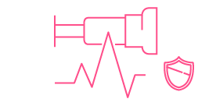
AWS Distro for OpenTelemetry
A secure, production-ready open source distribution supported by AWS
Upstream-first distro of the popular CNCF project
Certified by AWS for security and predictability
Backed by AWS support
One-click deploy and configure from AWS container and AWS Lambda consoles
Exporters for AWS monitoring solutions including – CloudWatch, X-Ray, Amazon OpenSearch Service, and AWS Partner Solutions
Notes:
AWS Distro for OpenTelemetry is an open source distribution downstream of OpenTelemetry. All the enhancements that AWS will be adding to OT will be done upstream. We will not fork the project. It will be a distribution of the project. The toolkit will be packaged and ready for production use. It will be well tested, validated for performance and security and will be backend by AWS support. It will also be up to date and will follow a release cycle. We will get latest code and features from upstream every 90 days and release a new backward compatible version. It will also be well integrated with container and lambda service consoles. For Lambda we will have a Lambda layer which can be included with your function code. In 2020, we will provide mechanisms to send data to CloudWatch, X-Ray, StealFire and Prometheus.
With the AWS Distro for OpenTelemetry .NET, you can instrument your applications once and send correlated metrics and traces to multiple AWS monitoring solutions including Amazon CloudWatch, AWS X-Ray, and Amazon OpenSearch Service. Using X-Ray with AWS Distro for OpenTelemetry requires two components: an OpenTelemetry SDK enabled for use with X-Ray, and the AWS Distro for OpenTelemetry Collector enabled for use with X-Ray.

Slide 39










AWS X-Ray
Analyze and Debug production and distributed applications
AWS X-Ray
AWS X-Ray helps you analyze, debug, and quantify impact on modern applications built using microservices and serverless architecture
Collect traces
Collect data about the request from each underlying application service it passes through
Record traces
X-Ray combines the data gathered from each service into singular units called traces
View service map
View the service map to see trace data, such as latencies, HTTP statuses, and metadata for each service
Analyze issues
Drill into the service showing unusual behavior to identify the root issue
Notes:
AWS X-Ray is a service that customers can use to monitor application traces, including the performance of calls to other downstream components or services. X Ray can consolidate information about an application architecture into service map, which includes connection to components and a dependency tree. It enables easier root cause analysis by highlighting part of the application that is problematic, offering details such as latency, HTTP response status and the number of errors.
helps developers to analyze and debug distributed applications.
X-Ray consolidates information about an application’s architecture into a Service Map, which also includes connections to components and a dependency tree. It enables easier root cause analysis by highlighting the part of the application that is problematic, offering request details such as latency, HTTP response status, and the number of errors. Some of the key features of Xray are:
Analyze and debug performance of distributed applications
Identify specific user impact across your applications
Customers use X-Ray to monitor application traces, including the performance of calls to other downstream components or services, in either cloud-hosted applications or from their own machines during developmen
How does AWS X-Ray help?
Analyze and debug performance of your distributed applications.
View latency distribution and pinpoint performance bottlenecks.
Identify specific user impact across your applications.
Works across different AWS and non-AWS services.
Ready to use in production with low latency in real-time.
AWS X-Ray integrates with Amazon Simple Queue Service (Amazon SQS) to trace messages that are passed through an Amazon SQS queue. If a service traces requests by using the X-Ray SDK, Amazon SQS can send the tracing header and continue to propagate the original trace from the sender to the consumer with a consistent trace ID. Trace continuity enables users to track, analyze, and debug throughout downstream services. The X-Ray SDK automatically populates the trace header as an HTTP header when you call Amazon SQS through the AWS SDK. The default trace header is carried by X-Amzn-Trace-Id and corresponds to all messages included in a SendMessage or SendMessageBatch request.
When your application makes calls to AWS services to store data, write to a queue, or send notifications, the X-Ray SDK for .NET tracks the calls downstream in subsegments. Traced AWS services and resources that you access within those services (for example, an Amazon S3 bucket or Amazon SQS queue), appear as downstream nodes on the service map in the X-Ray console.
You can instrument all of your AWS SDK for .NET clients by calling RegisterXRayForAllServices before you create them.
Enables you to get started quickly without having to manually instrument your application code to log metadata about requests
Let's navigate to AWS X-Ray now.
With AWS X-Ray, you can use traces collected from your AWS resources and managed services
to pinpoint and debug any issues, identify bottlenecks, and more.
To demonstrate the simple, automated, out-of-the-box experience of sending traces to X-Ray,

Slide 40
Observability demo

Slide 41

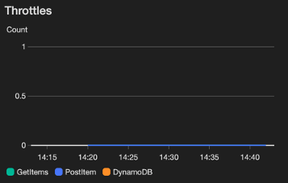
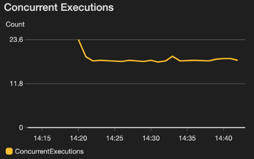
Observability
Operational excellence best practices
Observability is the way to govern the application’s health
Monitor with Amazon CloudWatch logs and metrics – understand, analyze, and alert on metrics provided out of the box
Inspect application traces with AWS X-Ray Console
Instrument code with OpenTelemetry or AWS X-Ray SDKs
AWS X-Ray
Amazon CloudWatch
logs and metrics
Notes:
Analyze and debug production, distributed applications
Identify performance bottlenecks
Troubleshoot root cause
Trace user requests
For simple & complex applications
not just one big monolith now it's many different systems talking to each other and that means when you're trying to reconstruct a chain of events to actually figure out where the error that the user saw came from or why the the page was slow when it loaded that's becoming harder and harder to do
the more distributed our systems are becoming uh so for example logging uh
all of these systems produce logs we're all used to looking at log data but if you try to reconstruct one of these big distributed transactions uh out of your logging system it becomes really difficult to do because you have to find and filter to just get the logs that were in your particular transaction and if you had a something like a transaction id
or as we'll call in a moment a trace id attached to all of these logs then you'd be able to do a query which
3:46
is find all the other logs that are in this transaction but with the traditional logging tool you don't have that because you don't
have that kind of contex
CloudWatch
Monitor applications
Respond to performance changes
Optimize resource utilization
Get a unified view of operational health

Slide 42
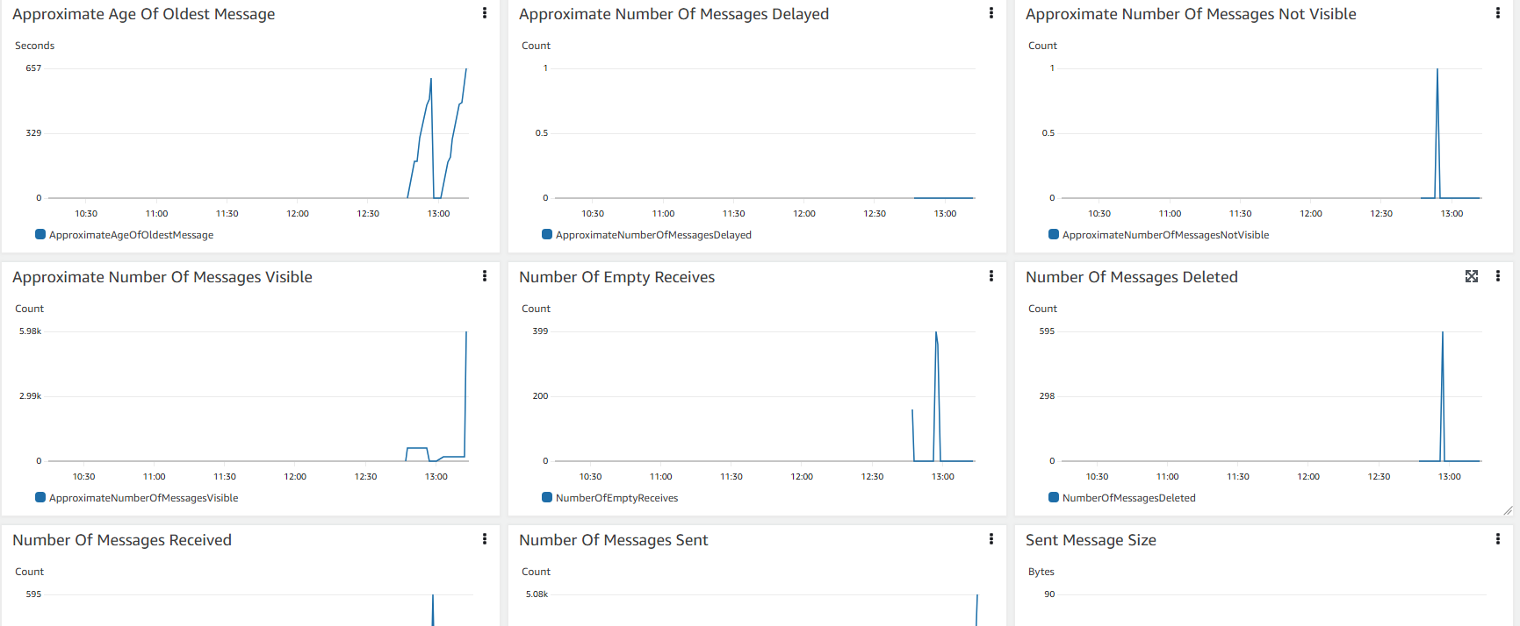
Monitoring
Notes:
Alarms and Events

Slide 43
Observability demo recap
Instrumenting AWS code automatically with the AWS NuGet package
OpenTelemetry.Contrib.Instrumentation.AWS
Instrumenting code manually with System.Diagnostics.Activity
Possible to add tags and events to activities
Deploy to Lambda using Lambda layer
Deploy to Amazon ECS with AWS Fargate using a sidecar container
Notes:
OTel provides a de facto standard for adding observable instrumentation to cloud-native applications. This means companies don’t need to spend valuable time developing a mechanism for collecting critical application data and can spend more time delivering new features instead.
It’s akin to how Kubernetes became the standard for container orchestration.

Slide 44


Key takeaway: Which service should I recommend?
Replace
Refactor
Pub/Sub
P-2-P
Standard
FIFO
Active MQ
Rabbit MQ
Amazon EventBridge
Amazon
SNS
Amazon
SQS
Amazon SQS (FIFO)
Amazon
MQ
Notes:
AWS offers multiple managed services to implement distributed architecture
AWS .NET SDK offers capabilities to integrate with managed integration services
Tracing and Logging are critical components of distributed architecture

Slide 45




Links
Event-driven architecture best practices
https://aws.amazon.com/event-driven-architecture/
Digital Course: Architecting Serverless Solutions
https://bit.ly/3T652cN
Workshop: Building event-driven architectures on AWS
https://bit.ly/3h4SPYu
Proposed .NET Message Library
https://bit.ly/3DJvwem
Notes:
Here are the links to further your knowledge..

Slide 46
Norm Johanson
Ashish Bhatia
@socketnorm
www.linkedin.com/in/ashish-bhatia-aws

